Slide 1

Work-let Name: CT006_RISC_V Vector Implementation of Channel Estimation and develop Custom vector Intrinsics of
Worklet Details
Worklet ID: CT006_RISC_V
College Name:Cambridge Institute of Technology Banglore
KPIs achieved till now
Matrix Multiplication executed for various matrix sizes (5×5, 16×16, 32×32, 64×64)
Peformance was analyzed by observing the number of clock cycles for matrix multipication of varying sizes.
Any Challenges/ Issues faced
Execution and display of large matrices in Ubuntu PULP showed errors due to their large size exceeding handling capacity.
Optimization inconsistency across different matrix sizes
Next Steps
Next step is to analyze performance for 512×512 and 1024×1024 matrices to evaluate execution cycle variation with size.
Key Achievements/ Outcome till now
Optimization of matrix multiplication core for various sizes
For matrix size 64×64, the executed output was correct and achieved with the least number of cycles, indicating optimized performance.
Date: 21-04-2025

Slide 2
Work-let Name: CT006_RISC_V Vector Implementation of Channel Estimation and develop Custom vector Intrinsics of
Worklet Details
Worklet ID: CT006_RISC_V
College Name: Cambridge Institute of Technology Banglore
Requirement: C compiler (e.g., GCC), simulation environment (e.g., MATLAB for validation), Linux/Windows OS, dataset for testing (MAT/CSV format)
Status: C environment setup complete; dataset under review; initial test code compiled and working
GitHub: https://github.com/yourusername/channel-estimation-c (replace with actual link)
Resource Requirement Identified with Status
Github Repository Link and PRISM Portal Registration
Status
Any Anticipated Break (Due to exams etc)
Internals
Is the data self-collected, If yes then is the consent form submitted.
If open source then the dataset link
Source: Open source dataset used for testing (e.g., 6G channel dataset)Link: https://github.com/ocatak/6g-channel-estimation-datasetConsent: Not applicable (open source)
Data Collection Information
Date: 21-04-2025

Slide 3
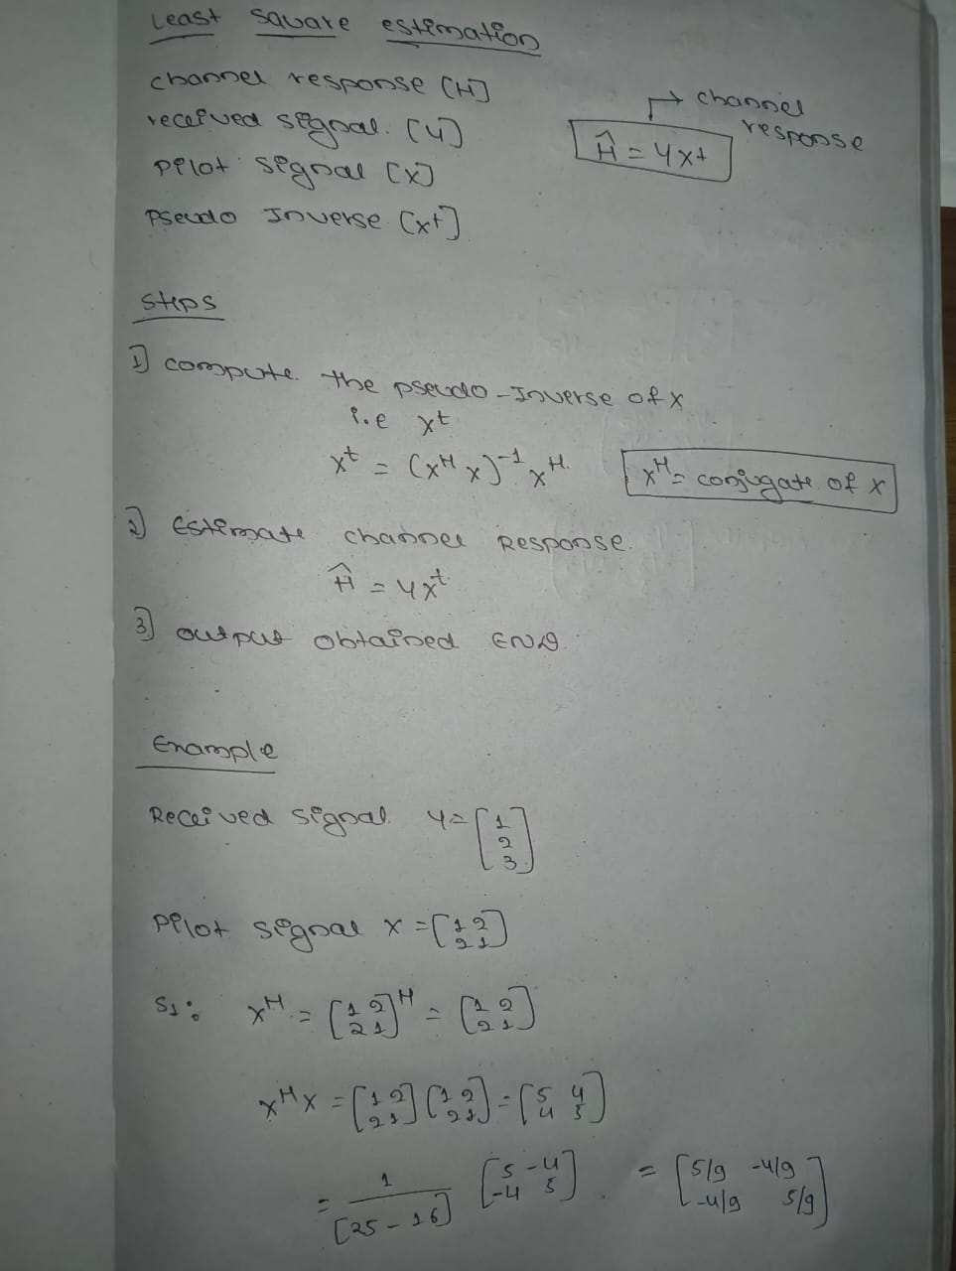
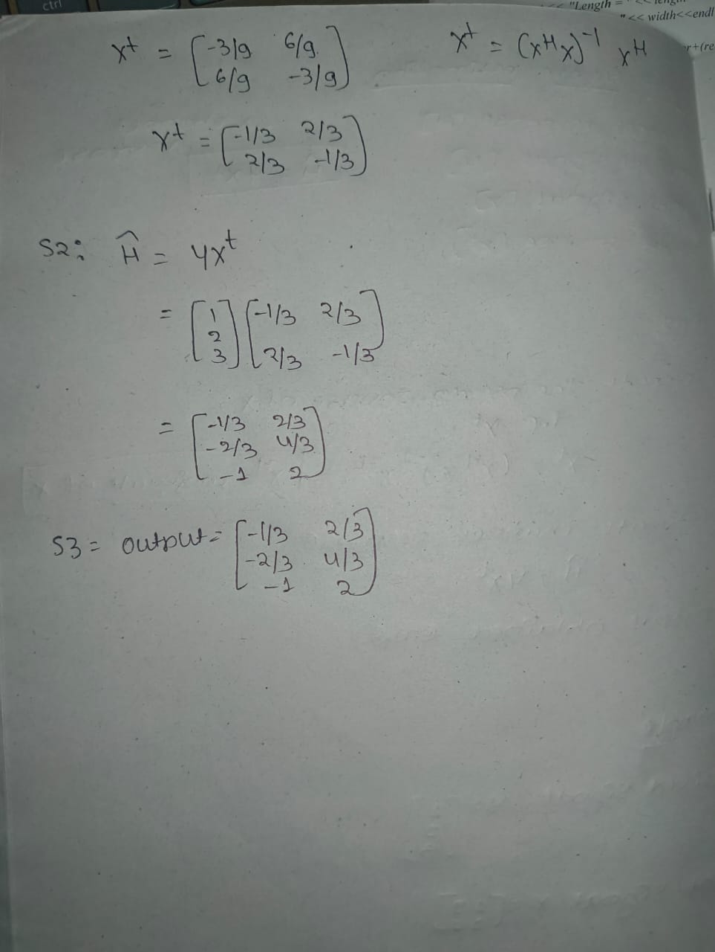
Work-let Name: CT006_RISC_V Vector Implementation of Channel Estimation and develop Custom vector Intrinsics of
Worklet Details
Worklet ID: CT006_RISC_V
College Name:Cambridge Institute of Technology Banglore
Least Square Estimation Algorithm
Date: 21-04-2025

Slide 4
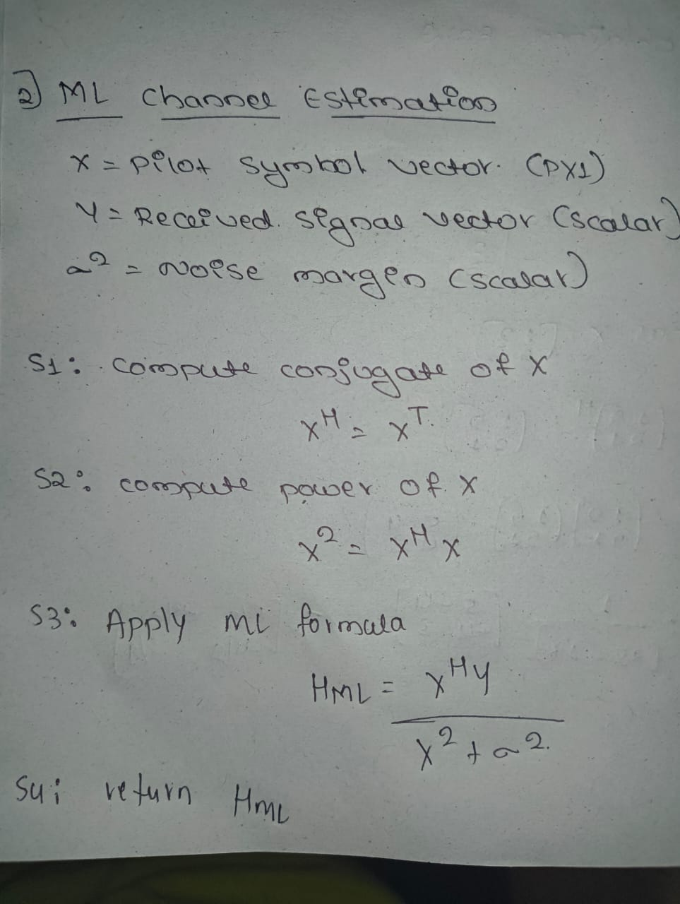
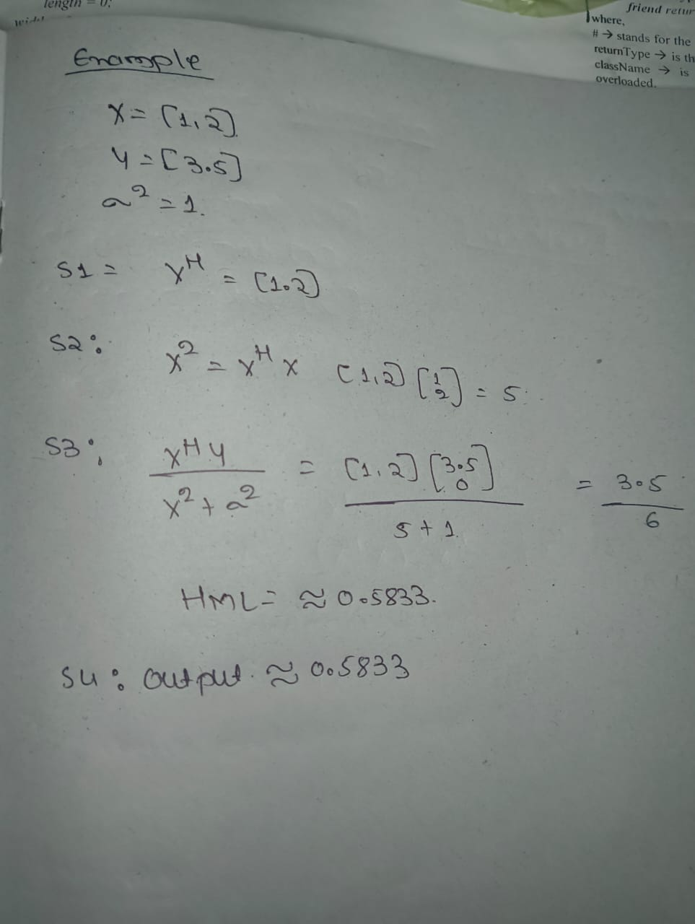
Work-let Name: CT006_RISC_V Vector Implementation of Channel Estimation and develop Custom vector Intrinsics of
Worklet Details
Worklet ID: CT006_RISC_V
College Name:Cambridge Institute of Technology Banglore
ML Channel Estimation Algorithm
Date: 21-04-2025

Slide 5
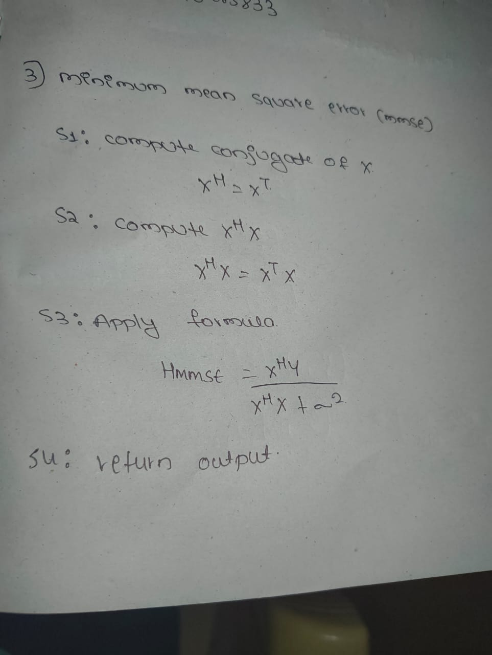
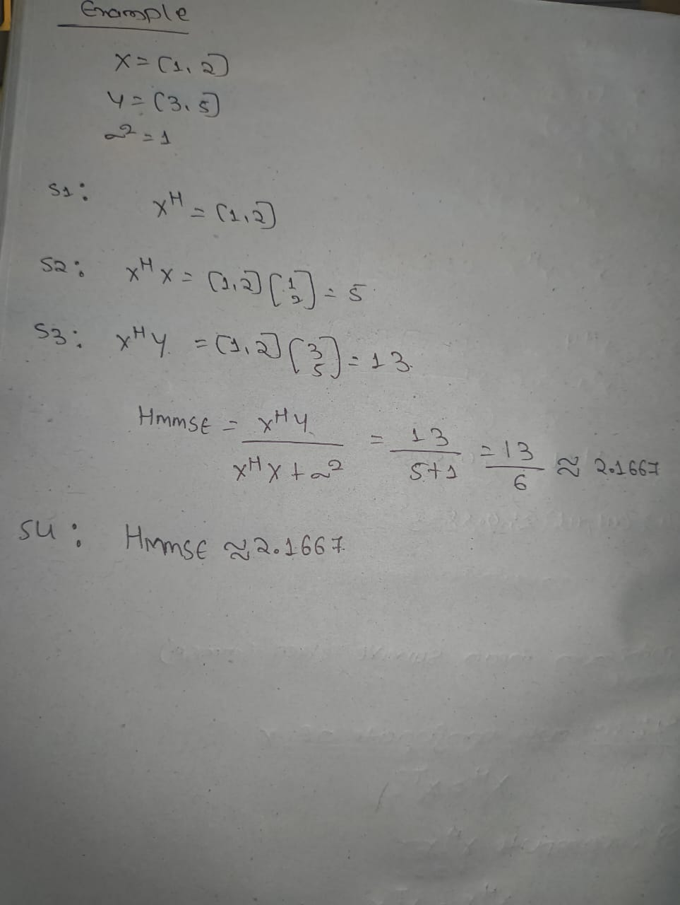
Work-let Name: CT006_RISC_V Vector Implementation of Channel Estimation and develop Custom vector Intrinsics of
Worklet Details
Worklet ID: CT006_RISC_V
College Name:Cambridge Institute of Technology Banglore
Minimum Square Error Algorith
Date: 21-04-2025

Slide 6
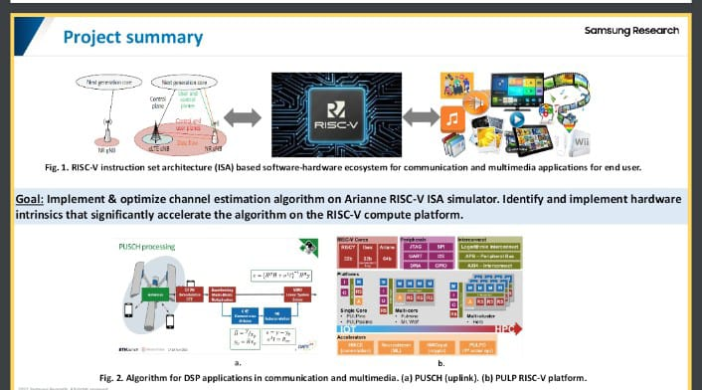
Work-let Name: CT006_RISC_V Vector Implementation of Channel Estimation and develop Custom vector Intrinsics of
Worklet Details
Worklet ID: CT006_RISC_V
College Name:Cambridge Institute of Technology Banglore
Block Diagram
Date: 21-04-2025

Slide 7
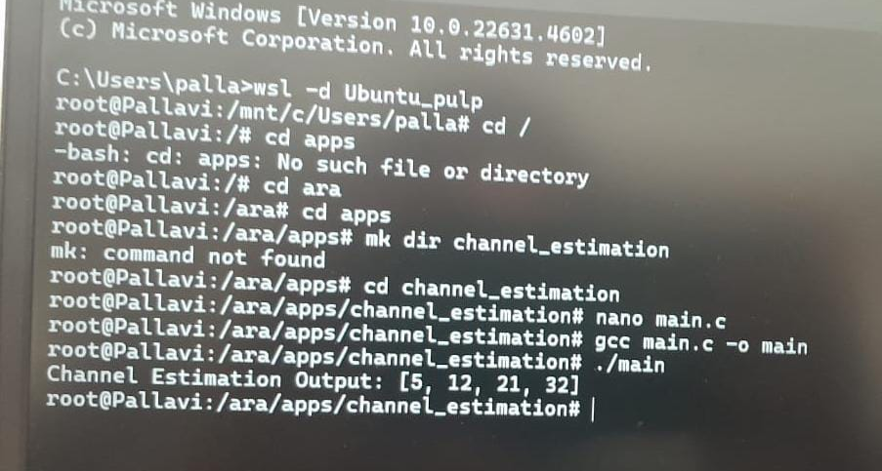
Work-let Name: CT006_RISC_V Vector Implementation of Channel Estimation and develop Custom vector Intrinsics of
Worklet Details
Worklet ID: CT006_RISC_V
College Name:Cambridge Institute of Technology Banglore
output for 1*1 matrix multiplication
Date: 21-04-2025

Slide 8
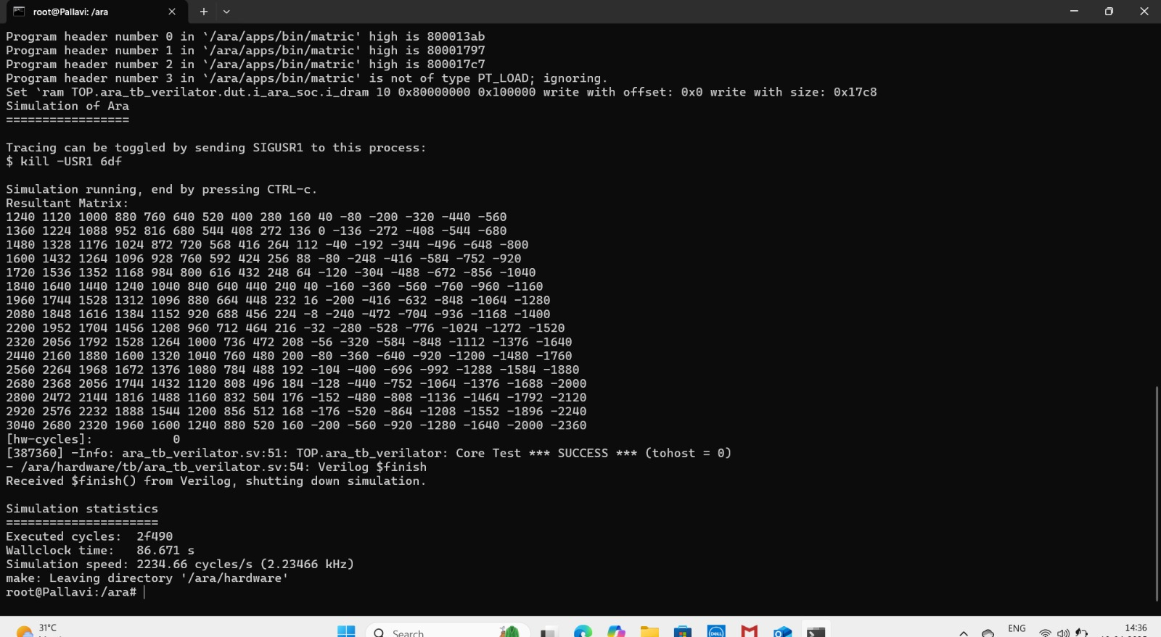
Work-let Name: CT006_RISC_V Vector Implementation of Channel Estimation and develop Custom vector Intrinsics of
Worklet Details
Worklet ID: CT006_RISC_V
College Name:Cambridge Institute of Technology Banglore
output for 16*16
Date: 21-04-2025

Slide 9
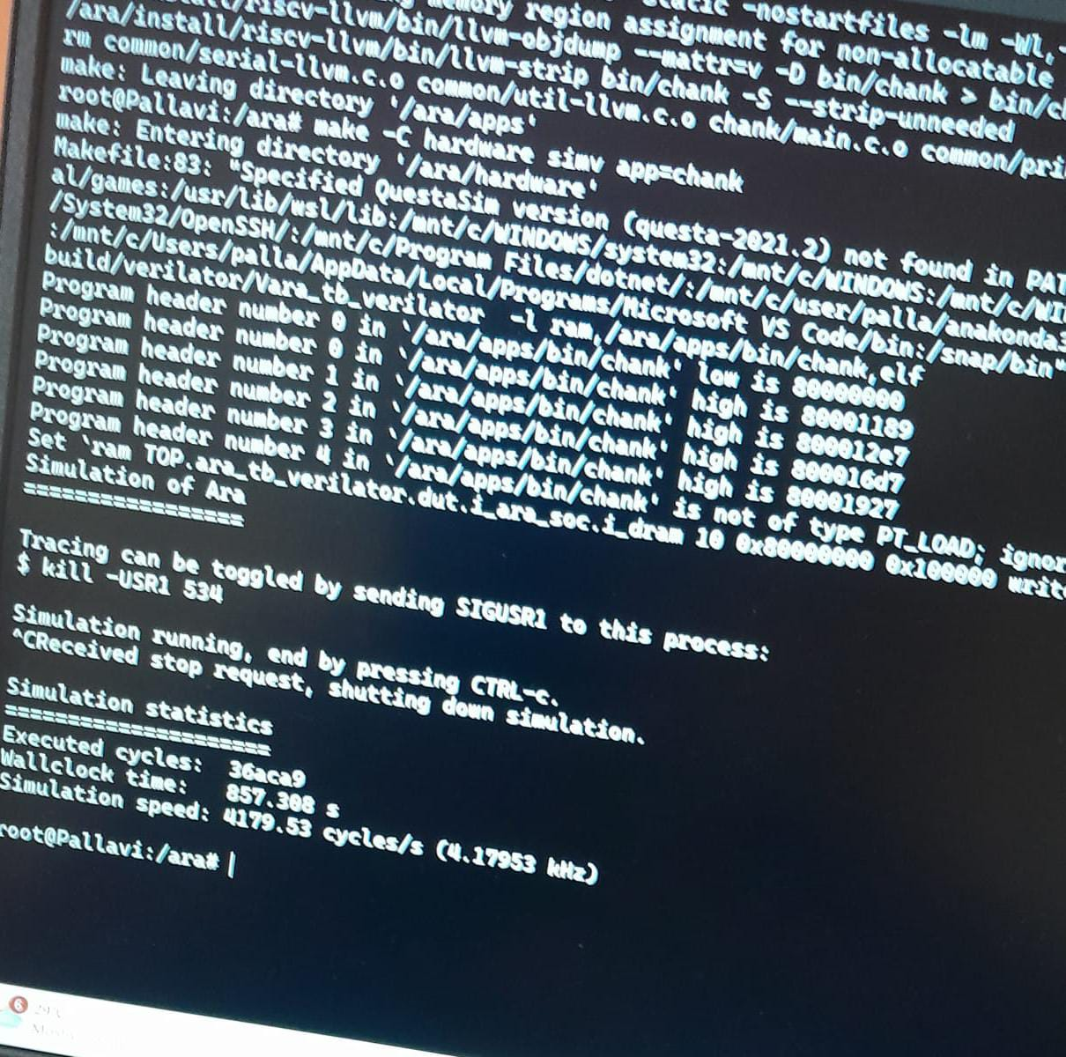
Work-let Name: CT006_RISC_V Vector Implementation of Channel Estimation and develop Custom vector Intrinsics of
Worklet Details
Worklet ID: CT006_RISC_V
College Name:Cambridge Institute of Technology Banglore
output for 64*64
Date: 21-04-2025

Slide 10
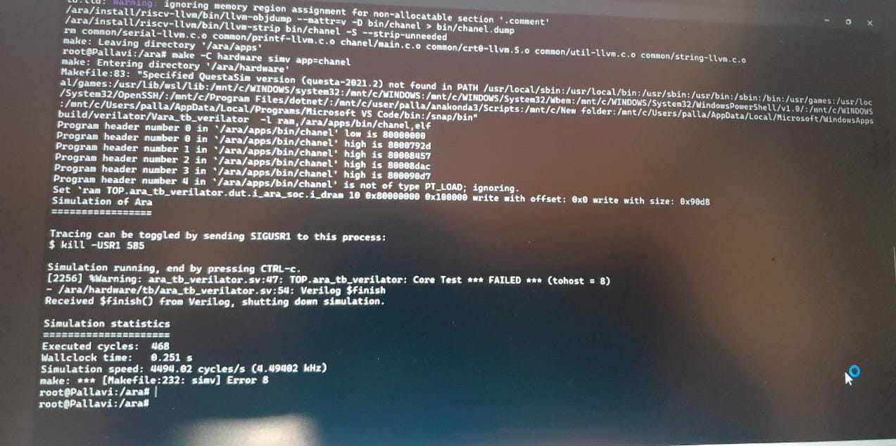
Work-let Name: CT006_RISC_V Vector Implementation of Channel Estimation and develop Custom vector Intrinsics of
Worklet Details
Worklet ID: CT006_RISC_V
College Name:Cambridge Institute of Technology Banglore
output for 1024*1024
Date: 21-04-2025

Slide 11
Work-let Name: CT006_RISC_V Vector Implementation of Channel Estimation and develop Custom vector Intrinsics of
Worklet Details
Worklet ID: CT006_RISC_V
College Name:Cambridge Institute of Technology Banglore
Status and future plan
Latest Literature Review
Expert Insights
Any other comment
Professor Comments (To be filled in and presented by professor (Either)
COMPUTATION RESOURCE Details:
[Google Collab/ Kaggle / GPU from College lab with compute hours etc]
Date: 21-04-2025

